Slide 1
M.S. Ramaiah Institute of Technology
(Autonomous Institute, Affiliated to VTU)
Department of Computer Science and Engineering
Course Name: Computer Organization and
Architecture
Course Code: CS45

Slide 2
Unit -1
Functional units, Bus structures, performance,
Overflow in integer arithmetic: Numbers, Arithmetic operations and characters
Memory locations and addresses,
Memory operations,
Instructions and instruction sequencing,
Addressing modes,
Subroutines and use of stack frames,
Encoding of machine instructions.

Slide 3
Introduction

Slide 4

What is Computer
All computers have in common: hardware and software.
Hardware is any part of your computer that has a physical structure, such as the keyboard or mouse.
Software is any set of instructions that tells the hardware what to do and how to do it. Examples of software include web browsers, games, and word processors.

Slide 5
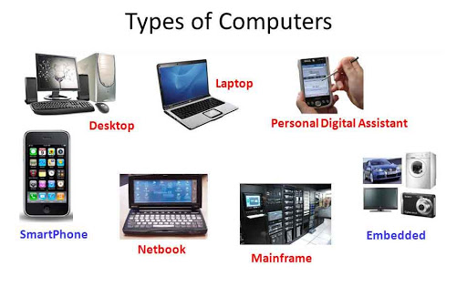
What are the different types of computers?

Slide 6
Analogy
A chef prepares a certain recipe, then serves it to the customers.
Chef knows how to prepare the food item whereas customer cares only about quality and taste of the food.
“customer” as computer organization
“chef” can referred to as computer architecture

Slide 7
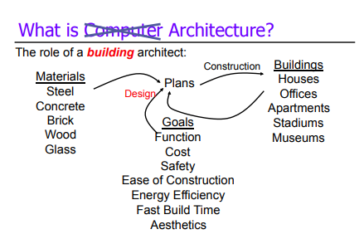
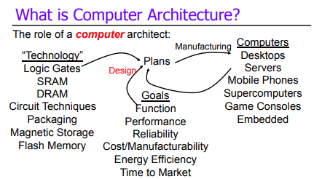
Analogy

Slide 8
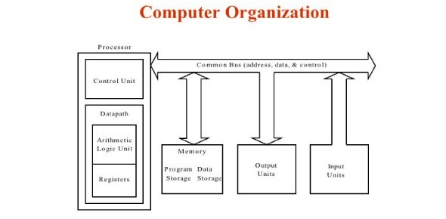
Computer organization
Computer Organization- The way hardware components are connected to form a computer system
In other words, it is mainly about the programmer’s or user point of view.
Organization - physical design of a computer
1.How many registers?
2. What is a register?
3. How many registers does a typical CPU have?

Slide 9
Computer Architecture
Structure and behaviour of the various functional units of the computer and their interactions
Basically, throws light on the designer’s point of view.

Slide 10
Computer Architecture
In a system, there are a set of instructions, it is enough for programmer or user to know what are a set of instructions present in case of computer organization
System designer worries about how a set of instructions are implemented, algorithm of implementation is the emphasis in the case of architectural studies.

Slide 11
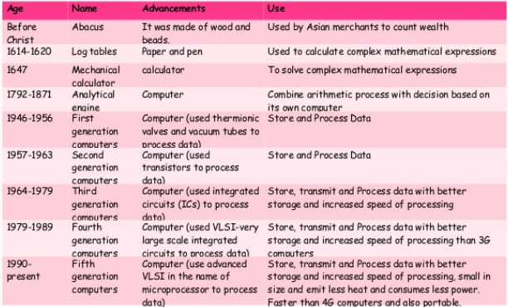
Generations of Computer

Slide 12
Unit -1
Functional units, Bus structures, performance,
Overflow in integer arithmetic: Numbers, Arithmetic operations and characters
Memory locations and addresses,
Memory operations,
Instructions and instruction sequencing,
Addressing modes,
Subroutines and use of stack frames,
Encoding of machine instructions.

Slide 13
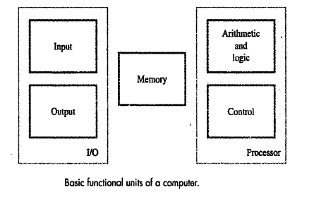
Functional Units
A Computer consist of 5 main parts

Slide 14
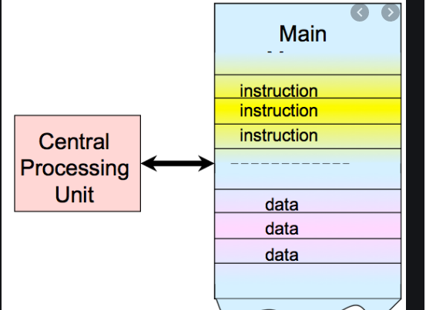
Functional Units
A computer program is a collection of instructions that can be executed by a computer to perform a specific task.

Slide 15
Functional Units
Central Processing Unit (CPU) consists of the following features
CPU is considered as the brain of the computer.
CPU performs all types of data processing operations.
It stores data, intermediate results, and instructions (program).
It controls the operation of all parts of the computer.
3 components inside CPU
Registers
Control unit
ALU(Arithmetic Logic Unit)

Slide 16
Functional Units
ALU (Arithmetic Logic Unit)
This unit consists of two subsections namely,
Arithmetic section
LogicSection
Arithmetic section
The function of arithmetic section is to perform arithmetic operations like addition, subtraction, multiplication, and division.
Logic Section
The function of the logic section is to perform logic operations such as comparing, selecting, matching, and merging of data.

Slide 17
Functional Units
Control unit
Functions of this unit are
It is responsible for controlling the transfer of data and instructions among other units of a computer.
It manages and coordinates all the units of the computer.
It obtains the instructions from the memory, interprets them, and directs the operation of the computer.
It communicates with Input/output devices for transfer of data or results from storage.
It does not process or store data.

Slide 18
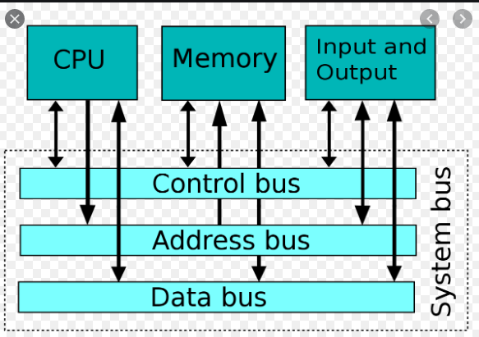
Bus Structure
There are many ways to connect different parts inside a computer together.
A group of lines that serves as a connecting path for several devices is called a bus.
Address/data/control

Slide 19
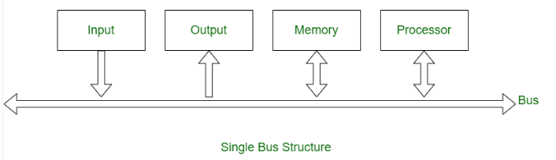
Bus Structure
Single-bus

Slide 20
Bus Structure
Speed Issue
Different devices have different transfer/operate speed.
Keyboard, printers are slow
Magnetic or optical disk are fast
Memory and processor are faster
If the speed of bus is bounded by the slowest device connected to it, the efficiency will be very low.
How to solve this?
A common approach – use buffers.

Slide 21
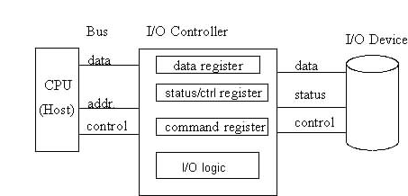
Bus Structure
A common approach – use buffers
Buffer register with every device to hold information using data transfer

Slide 22
Performance
The most important measure of a computer is how quickly it can execute programs.
Three factors affect performance:
Hardware design - Cache
Instruction set
Compiler design

Slide 23
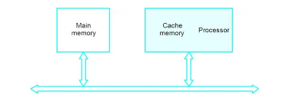
Performance – Hardware design
Processor time to execute a program depends on the hardware involved in the execution of individual machine instructions.

Slide 24
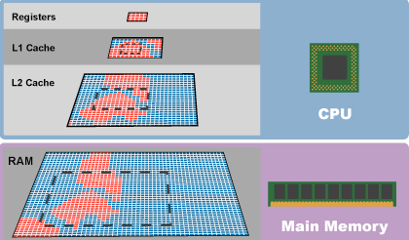
Performance – Hardware design
The processor and a relatively small cache memory can be fabricated on a single integrated circuit chip.
A cache is a special storage space for temporary files that makes a device run faster and more efficiently.
Speed
Cost
Memory management

Slide 25
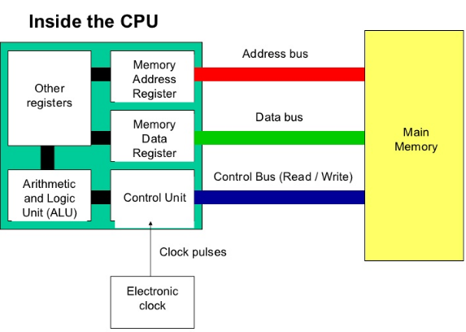
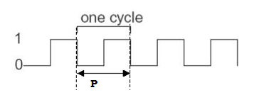
Performance – Hardware design
Processor circuits are controlled by a timing signal called clock.
Clock – defines regular time intervals called clock cycles
P – length of once clock cycle

Slide 26
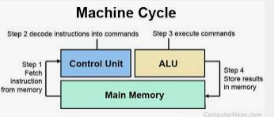
Performance – Hardware design
To execute a machine instruction, processor divides the action into 4 steps.
Each step take once clock cycle .

Slide 27
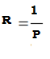
Performance – Hardware design
Clock rate(R)/Processor Speed
Is a measure of number of clock cycles per second.
CPU clock speed/clock rate, is measured in Hertz — generally in gigahertz, or GHz.

Slide 28
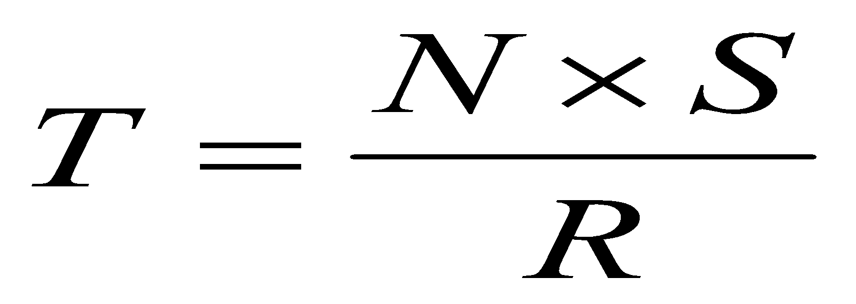
Basic Performance Equation
Performance – Hardware design
T – processor time required to execute a program that has been prepared in high-level language
N – number of actual machine language instructions needed to complete the execution
S – average number of basic steps needed to execute one machine instruction. Each step completes in one clock cycle
R – clock rate

Slide 29
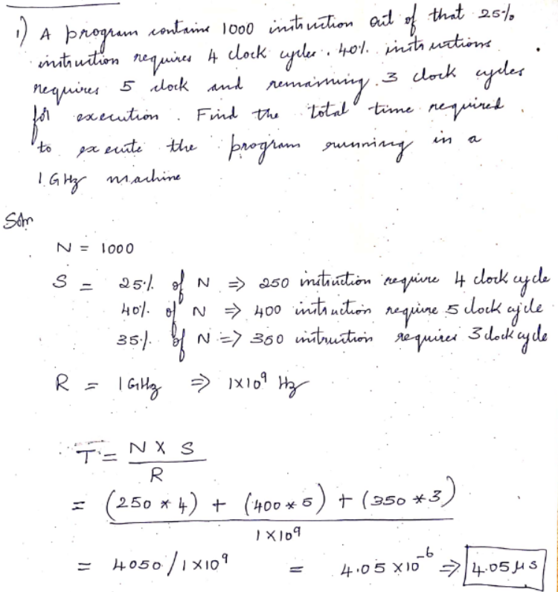

Slide 30
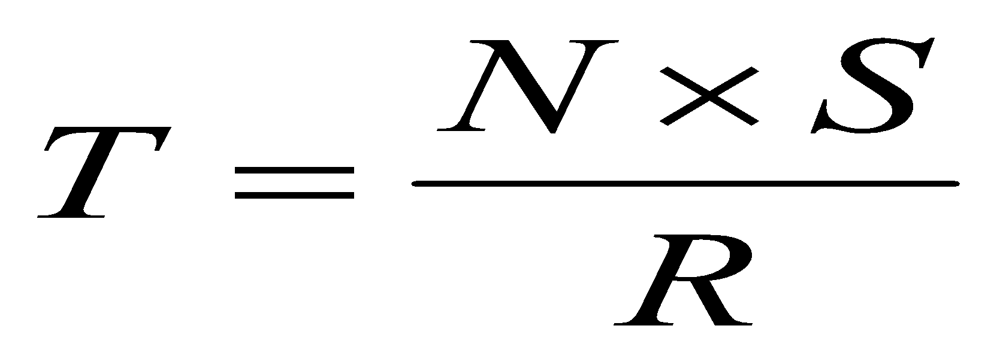
Basic Performance Equation
Performance – Hardware design
How to improve T?
Pipelining and Superscalar operation
Clock rate

Slide 31
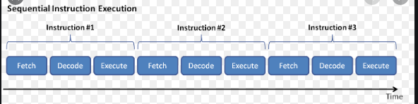
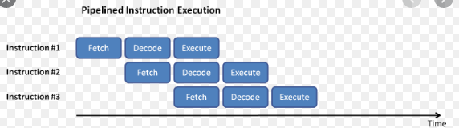
Pipelining
Performance – Hardware design
Instructions are not necessarily executed one after another.
Pipelining – overlapping the execution of successive instructions.

Slide 32
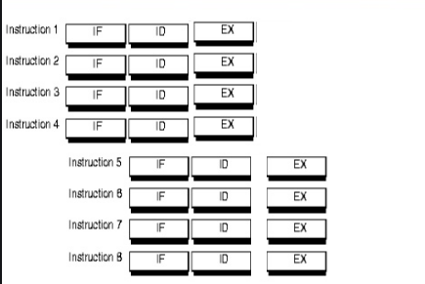
Performance – Hardware design
Pipelining – overlapping the execution of successive instructions.
Superscalar – Different instruction can be executed in parallel

Slide 33
Clock Rate
Performance – Hardware design
Increase clock rate
Improve the integrated-circuit (IC) technology to make the circuits faster
Reduce the amount of processing done in one basic step (however, this may increase the number of basic steps needed)

Slide 34
Performance – Instruction set
Processor can have simple instruction and complex instruction
Simple instruction requires a small number of steps to execute.
Complex instruction involve a large number of steps
The design of Instruction set of a Processor can be
Reduced Instruction Set Computer(RISC)
Complex Instruction Set Computer(CISC)

Slide 35
Performance – Instruction set
If a processor has only Simple instructions – Program will have large number of instructions
N – large value
S – small value
If a processor has only Complex instructions – Program will have lesser number of instructions
N – small value
S – large value

Slide 36
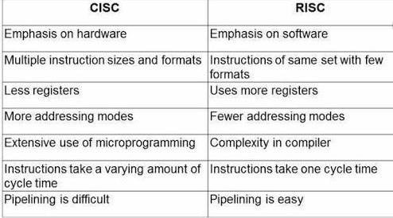
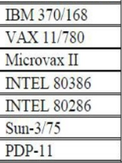
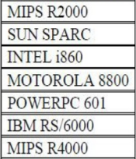
Performance – Instruction set

Slide 37
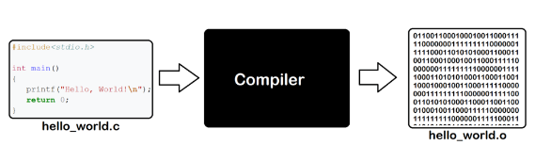
Performance – Compiler
A compiler translates a high-level language program into a sequence of machine instructions.

Slide 38
Performance – Compiler
A compiler may not be designed for a specific processor; however, a high-quality compiler is usually designed for a specific processor.
Goal – reduce N×S
To reduce N, we need a suitable machine instruction set and a compiler that makes good use of it.

Slide 39
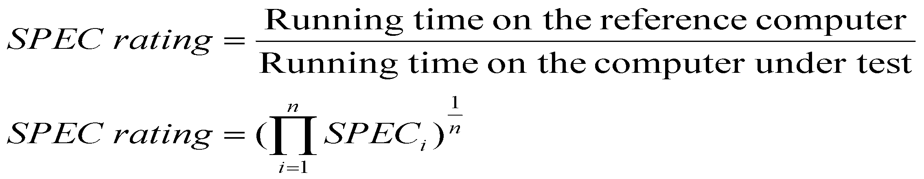
Performance – Measurement
T is difficult to compute
So, we can measure computer performance using benchmark programs.
System Performance Evaluation Corporation (SPEC) selects and publishes representative application programs for different application domains, together with test results for many commercially available computers.

Slide 40
Performance Summary
METRICS
Processor clock
Basic performance equation
Pipelining & super scalar operation
Clock rate
Instruction set CISC & RISC
Compiler
Performance measurement

Slide 41
Unit -1
Functional units, Bus structures, performance,
Overflow in integer arithmetic: Numbers, Arithmetic operations and characters
Memory locations and addresses,
Memory operations,
Instructions and instruction sequencing,
Addressing modes,
Subroutines and use of stack frames,
Encoding of machine instructions.

Slide 42
Number, Arithmetic Operations, and Characters
Let us learn
Binary number representation
Arithmetic operation on these number
Character representation

Slide 43
Number, Arithmetic Operations, and Characters
Computers are built using logic circuits that operate on information represented by two values 0 and 1.
The bit of information stands for binary digit
Represent number → string of bits called binary number
Represent Text character → string of bits called character code

Slide 44
Number, Arithmetic Operations, and Characters
Integer number are represented in two forms
Signed integer
Unsigned integer
Unsigned integer number represent positive numbers.
Computer does not have provision to represent negative sign, so various techniques are used

Slide 45
Number, Arithmetic Operations, and Characters
Computers are built using logic circuits that operate on information represented by two values 0 and 1.
The bit of information stands for binary digit
Represent number → string of bits called binary number
Represent Text character → string of bits called character code

Slide 46
Number, Arithmetic Operations, and Characters
Number representation
Various techniques to represent signed integer number are
Sign and magnitude
One’s complement
Two’s complement

Slide 47
Number, Arithmetic Operations, and Characters
Integer number are represented in two forms
Signed integer
Unsigned integer
Unsigned integer number represent positive numbers.
Computer does not have provision to represent negative sign, so various techniques are used

Slide 48
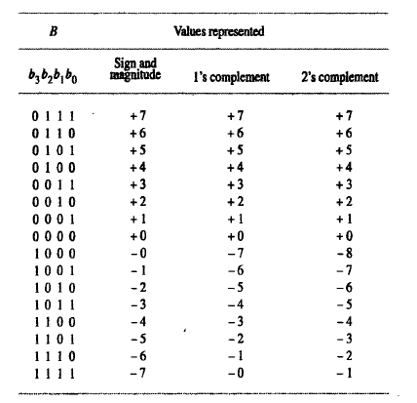
Number, Arithmetic Operations, and Characters

Slide 49
Number, Arithmetic Operations, and Characters
Assumptions:
4-bit machine word
16 different values can be represented
Roughly half are positive, half are negative

Slide 50
Number, Arithmetic Operations, and Characters

Slide 51
Sign-and-magnitude system
Plus(+) sign to represent positive number and Minus(-) sign to represent negative number
Positive number and Negative number are represented with binary digits. The leftmost bit(sign bit) in the number represent sign of the number. The remaining bits represent magnitude of number
Signed magnitude format for 4-bit signed number
b₃ | b₂ | b₁ | b₀
MSB = 0, then number is +ve
MSB = 1, then number is -ve
MSB
LSB
Sign
Magnitude

Slide 52
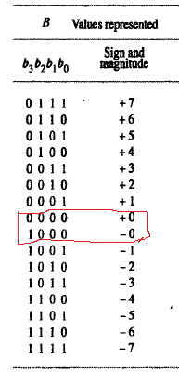
Sign-and-magnitude system
 | b₃ | b₂ | b₁ | b₀
+0 | 0 | 0 | 0 | 0
-0 | 1 | 0 | 0 | 0

Slide 53
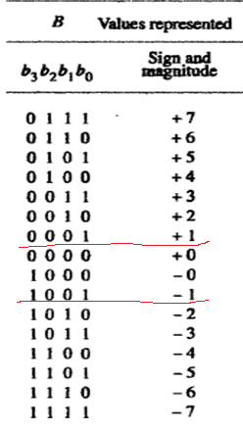
Sign-and-magnitude system
 | b₃ | b₂ | b₁ | b₀
+1 | 0 | 0 | 0 | 1
-1 | 1 | 0 | 0 | 1

Slide 54
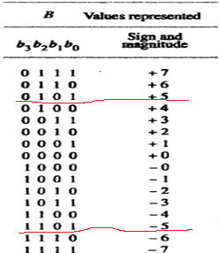
Sign-and-magnitude system
 | b₃ | b₂ | b₁ | b₀
+5 | 0 | 1 | 0 | 1
-5 | 1 | 1 | 0 | 1
5
2
2
2
1
1
0

Slide 55
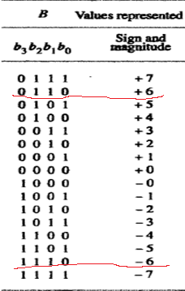
Sign-and-magnitude system
 | b₃ | b₂ | b₁ | b₀
+6 | 0 | 1 | 1 | 0
-6 | 1 | 1 | 1 | 0
2
6
2
3
0
1
1

Slide 56
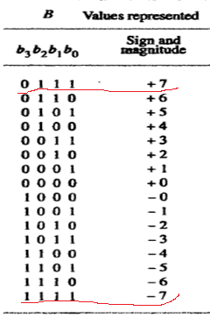
Sign-and-magnitude system
 | b₃ | b₂ | b₁ | b₀
+7 | 0 | 1 | 1 | 1
-7 | 1 | 1 | 1 | 1
7
2
2
3
1
1
1

Slide 57
Sign-and-magnitude system
For addition and subtraction, it is necessary to consider signs of both the number and their relative magnitude in order to carry out the required arithmetic operation
There are two representation of zero(0)
+0 → 0000
-0 → 1000
Due to this, it is difficult to test for zero operation frequently
performed by computer

Slide 58
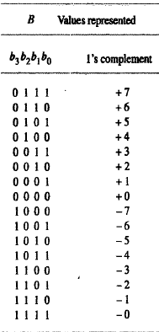
1's complement system
The 1’s complement of a binary number is the number that results when we change all 1’s to zeros and the zeros to 1’s.

Slide 59
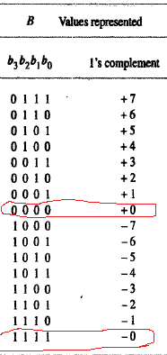
1's complement system
 | b₃ | b₂ | b₁ | b₀
+0 | 0 | 0 | 0 | 0
-0 | 1 | 1 | 1 | 1

Slide 60
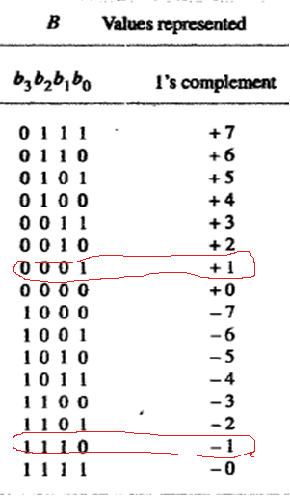
1's complement system
 | b₃ | b₂ | b₁ | b₀
+1 | 0 | 0 | 0 | 1
-1 | 1 | 1 | 1 | 0

Slide 61
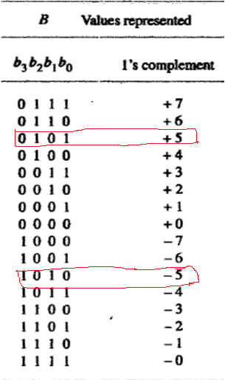
1's complement system
 | b₃ | b₂ | b₁ | b₀
+5 | 0 | 1 | 0 | 1
-5 | 1 | 0 | 1 | 0
5
2
2
2
1
1
0

Slide 62
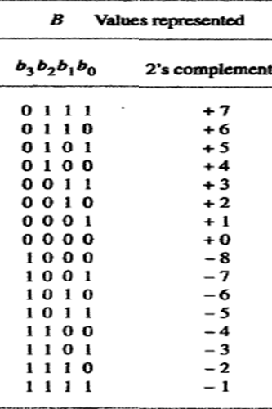
2's complement system
The 2’s complement is the binary number that results when we add 1 to the 1’s complement.
2’s complement = 1’complement +1

Slide 63
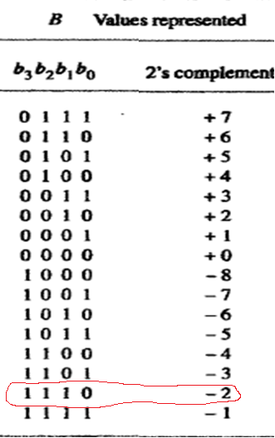
2's complement system
C |  |  |  | 1
 | +2 | 0 | 0 | 1 | 0
 | 1’s | 1 | 1 | 0 | 1
 |  |  |  |  | 1
 | -2 | 1 | 1 | 1 | 0

Slide 64
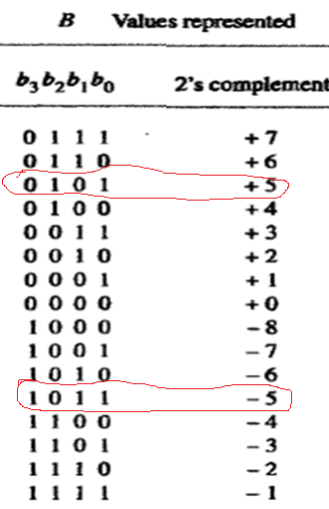
5
2's complement system
2
2
2
1
1
0
C
 | +5 | 0 | 1 | 0 | 1
 | 1’s | 1 | 0 | 1 | 0
 |  |  |  |  | 1
 | -5 | 1 | 0 | 1 | 1

Slide 65
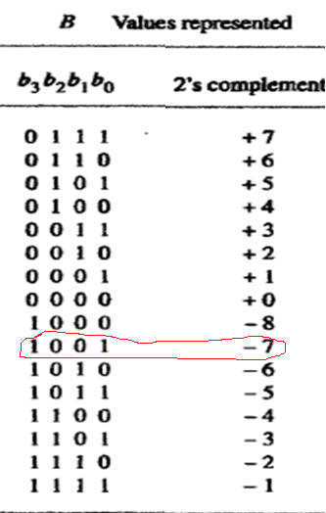
7
2's complement system
2
2
3
1
C
 | +7 | 0 | 1 | 1 | 1
 | 1’s | 1 | 0 | 0 | 0
 |  |  |  |  | 1
 | -7 | 1 | 0 | 0 | 1
1
1

Slide 66
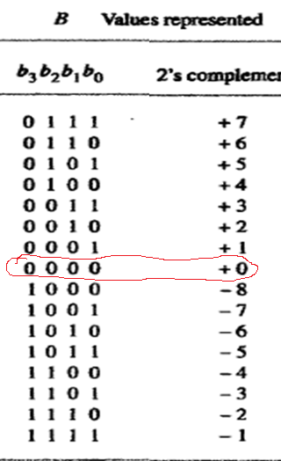
2's complement system
C | 1 | 1 | 1 | 1
 | +0 | 0 | 0 | 0 | 0
 | 1’s | 1 | 1 | 1 | 1
 |  |  |  |  | 1
 | -0 | 0 | 0 | 0 | 0

Slide 67
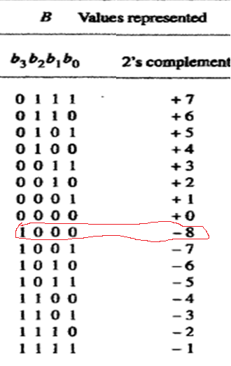
2's complement system
Advantages
Here One representation for +0 and -0
Here -8 is representable
Most efficient way to carry out addition and subtraction operations
Most often used in computers

Slide 68
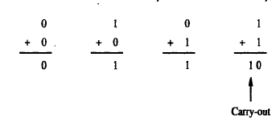
ADDITION OF POSITIVE NUMBERS
Consider adding two 1-bit numbers.
The sum of 1 & 1 requires the 2-bit vector 10 to represent the value 2.
We say that sum is 0 and the carry-out is 1.
Carry out | 1
 |  | 1
 |  | 1
sum |  | 0

Slide 69
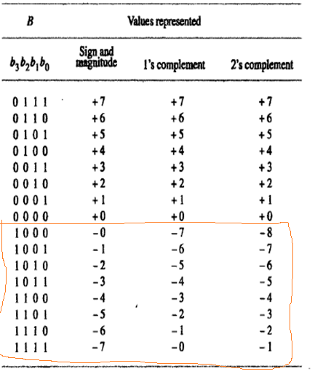
Number, Arithmetic Operations, and Characters
Various techniques
Sign and magnitude
One’s complement
Two’s complement
They differ in the way we represent negative numbers

Slide 70
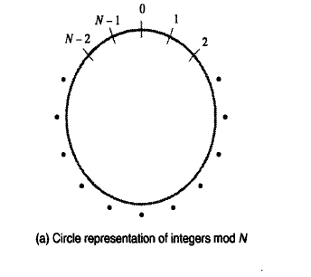
To understand 2’s complement arithmetic
Consider addition
modulo N(mod N)
A Graphical device of addition mod N of positive integers is a circle with N values ( 0 to N-1)along its perimeter
Use this device to compute
(a+b) mod N

Slide 71
To understand 2’s complement arithmetic
Consider the case N=16
(a + b) mod N
(7 +4) mod 16
= 11
Locate 7 on the circle and then move 4 units in the clockwise direction to arrive at the answer 11
15
14
13
3
12
4
11
5
10
6
9
7
8

Slide 72
To understand 2’s complement arithmetic
Consider the case N=16
(a + b) mod N
(9 +14) mod 16
23 mod 16
= 7
Locate 9 on the circle and then move 14 units in the clockwise direction to arrive at the answer 7
15
14
13
3
12
4
11
5
10
6
9
7
8

Slide 73
ADDITION & SUBTRACTION OF SIGNED NUMBERS
Two rules for addition and subtraction of n-bit signed numbers using the 2's complement representation system
Rule 1:
To Add two numbers, add their n-bits and ignore the carry-out signal from the MSB position.
Result will be algebraically correct, if it lies in the range -2^{n-1} to +2^{n-1}-1.
Rule 2:
To Subtract two numbers X and Y (that is to perform X-Y), take the 2's complement of Y and then add it to X as in rule 1.
Result will be algebraically correct, if it lies in the range -2^{n-1} to +2^{n-1}-1.

Slide 74
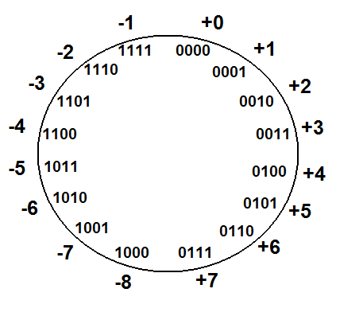
ADDITION OF SIGNED NUMBERS
Rule 1:
To Add two numbers, add their n-bits and ignore the carry-out signal from the MSB position.
Result will be algebraically correct, if it lies in the range -2^{n-1} to +2^{n-1}-1.
n = 4 bits → - 2⁴⁻¹ to + 2⁴⁻¹ - 1
⁻ 2³ to + 2³ - 1
-8 to +7

Slide 75
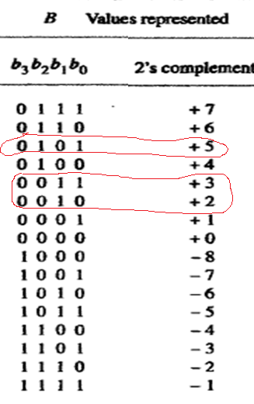
Addition rule
2's complement system
C |  |  | 1
 | +2 | 0 | 0 | 1 | 0
 | +3 | 0 | 0 | 1 | 1
 | +5 | 0 | 1 | 0 | 1

Slide 76
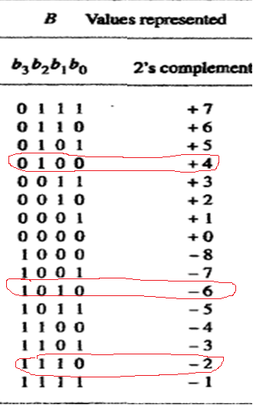
Addition rule
2's complement system
C
 | +4 | 0 | 1 | 0 | 0
 | -6 | 1 | 0 | 1 | 0
 | -2 | 1 | 1 | 1 | 0

Slide 77
Addition rule
2's complement system
C | 1 | 1 | 1
 | -5 | 1 | 0 | 1 | 1
 | -2 | 1 | 1 | 1 | 0
s | -7 | 1 | 0 | 0 | 1

Slide 78
SUBTRACTION OF SIGNED NUMBERS
Rule 2:
To Subtract two numbers X and Y (that is to perform X-Y), take the 2's complement of Y and then add it to X as in rule 1.
Result will be algebraically correct, if it lies in the range -2^{n-1} to +2^{n-1}-1.
n = 4 bits → - 2⁴⁻¹ to + 2⁴⁻¹ - 1
⁻ 2³ to + 2³ - 1
-8 to +7

Slide 79
Subtraction rule
2's complement system
 | 1 | 1 | 1 | 1
X | -3 | 1 | 1 | 0 | 1
Y | -7 | 0 | 1 | 1 | 1
X-Y | +4 | 0 | 1 | 0 | 0
C
Y | -7 | 1 | 0 | 0 | 1
 | 1’s | 0 | 1 | 1 | 0
 |  |  |  |  | 1
 |  | 0 | 1 | 1 | 1

Slide 80
Subtraction rule
2's complement system
 | 1 | 1
X | +6 | 0 | 1 | 1 | 0
Y | +3 | 1 | 1 | 0 | 1
X-Y | +3 | 0 | 0 | 1 | 1
C
Y | +3 | 0 | 0 | 1 | 1
 | 1’s | 1 | 1 | 0 | 0
 |  |  |  |  | 1
 |  | 1 | 1 | 0 | 1

Slide 81
Subtraction rule
2's complement system
 | 1 | 1 | 1 | 1
X | -7 | 1 | 0 | 0 | 1
Y | +1 | 1 | 1 | 1 | 1
X-Y | -8 | 1 | 0 | 0 | 0
C
Y | +1 | 0 | 0 | 0 | 1
 | 1’s | 1 | 1 | 1 | 0
 |  |  |  |  | 1
 |  | 1 | 1 | 1 | 1

Slide 82
Subtraction rule
2's complement system
 |  |  | 1
X | +2 | 0 | 0 | 1 | 0
Y | -3 | 0 | 0 | 1 | 1
X-Y | +5 | 0 | 1 | 0 | 1
C
Y |  | 1 | 1 | 0 | 1
 | 1’s | 0 | 0 | 1 | 0
 |  |  |  |  | 1
 |  | 0 | 0 | 1 | 1

Slide 83
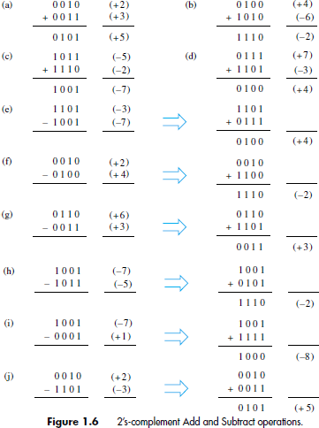

Slide 84
OVERFLOW IN INTEGER ARITHMETIC
Example of addition and subtraction in 4-bit example, answers fall in the range of -8 and +7.
When answers do not fall within this range, we say that overflow has occurred

Slide 85
OVERFLOW IN INTEGER ARITHMETIC
When result of an arithmetic operation is outside the representable range, an arithmetic overflow is said to occur.
Examine the signs of the two summands X and Y and sign of the result. When both operands X and Y have the same sign, an overflow occurs when the sign of S is not the same as sign of X and Y.

Slide 86
OVERFLOW IN INTEGER ARITHMETIC
The rules for detecting overflow in a two's complement sum are simple:
If the sum of two positive numbers yields a negative result, the sum has overflowed.
If the sum of two negative numbers yields a positive result, the sum has overflowed.
Otherwise, the sum has not overflowed.

Slide 87
OVERFLOW IN INTEGER ARITHMETIC
Perform following operation on the 4-bit signed numbers using 2’s complement representation system. Also indicate whether overflow has occurred. (+7) + (+4)
C | 0 | 1
X | +7 | 0 | 1 | 1 | 1
Y | +4 | 0 | 1 | 0 | 0
S | -5 | 1 | 0 | 1 | 1
Overflow has occurred

Slide 88
OVERFLOW IN INTEGER ARITHMETIC
Perform following operation on the 4-bit signed numbers using 2’s complement representation system. Also indicate whether overflow has occurred. (-5) + (-6)
C | 1 |  | 1
X | -5 | 1 | 0 | 1 | 1
Y | -6 | 1 | 0 | 1 | 0
S | +5 | 0 | 1 | 0 | 1
Overflow has occurred

Slide 89
OVERFLOW IN INTEGER ARITHMETIC
Perform following operation on the 4-bit signed numbers using 2’s complement representation system. Also indicate whether overflow has occurred. (+7) + (-4)
C | 1 | 1
X | +7 | 0 | 1 | 1 | 1
Y | -4 | 1 | 1 | 0 | 0
S | +3 | 0 | 0 | 1 | 1
No Overflow

Slide 90

CHARACTERS
Character can be letters of the alphabet , decimal digits, punctuation marks and so on.
Are represented by codes(ASCII -7bits and EBDIC – 8bits )
ASCII American standard committee on Information Interchange
EBDIC Extended Binary coded Decimal Interchange code

Slide 91
Unit -1
Functional units, Bus structures, performance,
Overflow in integer arithmetic: Numbers, Arithmetic operations and characters
Memory locations and addresses,
Memory operations,
Instructions and instruction sequencing,
Addressing modes,
Subroutines and use of stack frames,
Encoding of machine instructions.

Slide 92
Memory Location and Addresses
What is Memory
It is a storage unit, a place to hold data and instruction.

Slide 93

Memory Location and Addresses
Memory Organisation
Memory consist of many millions of storage cells.
Each cell can store 1-bit information having value (0 or 1)
Memory organized as group of n-bits

Slide 94

Memory Location and Addresses
Group of n-bits is referred as word
n is called word length
The word length of 8 bit is known as byte
Word length can range from 16 to 64bits, simple called word.

Slide 95

Memory Location and Addresses
Memory Location
Memory is divided into multiple small parts, of fixed size and capable of holding information.
Memory Address
Each memory location is uniquely identified by a BINARY ADDRESS(HEXA VALUE).

Slide 96
Memory Location and Addresses
Memory Address
If 2^{k} addresses constitute the address space of computer, then memory can have up to 2^{k} addressable locations.
Example
k= 10 , 2¹⁰ = 1,024(1K kilo) locations
k= 20 , 2²⁰ = 1,048,576(1M mega) locations
k= 24 , 2²⁴ = 16,777,216(16M mega) locations
k= 30 , 2³⁰ = 1G (giga) locations
k= 32 , 2³² = 4G (giga) locations
k= 40 , 2⁴⁰ = 1T(tera) locations

Slide 97

Memory Location and Addresses
If the word length is 32 bits, single word can store 32 bits or 4 ASCII characters as shown in the Figure .

Slide 98
Memory Location and Addresses
It is impractical for bit address locations
But prefer byte address location – byte addressable memory
Byte Addressable memory
Each Memory address refers to a single byte of storage. To store data of large size, multiple consecutive locations are used

Slide 99

Memory Location and Addresses
Two ways Byte address can be assigned across words
Big-Endian Assignments
Little-Endian Assignments

Slide 100



Memory Location and Addresses
Big Endian
The MSB of the data is placed at the byte with the lowest address.
Little Endian
The LSB of the data is placed at the byte with the lowest address.

Slide 101

Memory Operations
Load (or Read or Fetch)
Copy the content. The memory content doesn’t change.
Address – Load
Registers can be used
Store (or Write)
Overwrite the content in memory
Address and Data – Store
Registers can be used

Slide 102
Instruction and Instruction sequencing
Computer performs 4 types of operations:
Data transfer between memory and processor
Arithmetic and logic operations on data
Program sequencing and control
I/O transfers

Slide 103
Data Transfer
Transfer data from one location to another location
Memory locations
Processor registers
Registers in I/O system
Location is given symbolic name
Name for memory address location A,LOC,VAR,PLACE
Name for Processor register names R1,R2,R3…..
Name for I/O register names DATAIN,DATAOUT

Slide 104
Data Transfer
Register Transfer Notation
Assembly Language Notation

Slide 105
Data Transfer
R3 ← [R1] + [R2]
This type of notation is called RTN (Register Transfer Notation)
Processor
R1 =10
R2 = 20
R3 = 30

Slide 106
Data Transfer
Contents of location are denoted by placing square brackets around the name of the location
R1 ← [LOC]
Processor
R1 =10
Memory address | Memory location
LOC | 10

Slide 107
Data Transfer
Assembly Language Notation
Move LOC, R1
Processor
R1 =10
Memory address | Memory location
LOC | 10

Slide 108
Data Transfer
Assembly Language Notation
Add R1,R2,R3
Processor
R1 =10
R2 = 20
R3 = 30

Slide 109
Instruction and Instruction sequencing
Basic instruction types
Three address instruction format
Two address instruction format
One address instruction format
Zero address instruction format

Slide 110
Basic Instruction Types
Instruction
Opcode
Operand(s) or Address(es)
To represent machine instruction and program, we use assembly language format.
General 3 address instruction format
Source 1, Source 2 are source operands
Destination are called destination operands
Operation Source1, Source 2, Destination
Operands

Slide 111
Basic Instruction Types
Example C= A+B
Add the value of variable A and B and store in C
During compilation three variables A,B,C are assigned to distinct locations in memory
Action
C ← [A]+[B]
Memory address | Memory location
A | 10
B | 20
C | 30

Slide 112
Basic Instruction Types
Three address instruction format
This instruction contain memory address of three operands
Operands A and B – Source operand
Operand C – Destination operand
Add A, B ,C

Slide 113
Basic Instruction Types
Three address instruction format
Operands A , B,C are memory address - k bits
3 * 1000 = 3kbits for addressing purpose
Operation Add – n bits
Modern Processor is 32bit address space, then 3 address instruction format is too large to fit in one word
So multiple word is required for single instruction
Add A, B ,C

Slide 114
Basic Instruction Types
Two address instruction format
B ← [A]+[B]
But here we are replacing the
Content of original location B
Operation Source, Destination
Add A, B
Memory address | Memory location
A | 10
B | 20 30

Slide 115
Basic Instruction Types
Two address instruction format
Operation Source, Destination
Move B, C
Add A, C
Memory address | Memory location
A | 10
B | 20
C | 30

Slide 116
Basic Instruction Types
One address instruction format
Operand Specified in instruction can be source or destination, depending on the instruction
Operation Operand

Slide 117
Basic Instruction Types
One address instruction format
When second operand is required, processor register like Accumulator can be used
Operation Operand
Add A

Slide 118
Basic Instruction Types
One address instruction format
Add the content of memory location to the content of Accumulator
and store the result in accumulator
Add A
Memory address | Memory location
A | 10
Processor
Acc= 20
20+10 = 30

Slide 119
Basic Instruction Types
One address instruction format
Operand Specified in instruction can be source or destination, depending on the instruction
Operation Operand
Source Operand
Load A
Store A
Destination Operand

Slide 120
Basic Instruction Types
Load A - copies the contents of memory location A into accumulator
Add A
Load A
Store A
Memory address | Memory location
A | 10
Processor
Acc= 10

Slide 121
Basic Instruction Types
Store A - copies the contents of accumulator into memory location A
Add A
Load A
Store A
Memory address | Memory location
A | 20
Processor
Acc= 20

Slide 122
Basic Instruction Types
Load A
Add B
Store C
C ← [A]+[B]
Add A,B,C
Memory address | Memory location
A | 5
B | 10
C | 15
Processor
Acc= 5
= 5+10
= 15

Slide 123
Basic Instruction Types
Processor has several general purpose register
Many instruction involve operands that are in the register
Processor computations are performed directly on data held in processor register
Processor
R1 =10
R2 =20
R3 =30
Add R_{i}, R_{j} or
Add R_{i}, R_{j} , R_{k}

Slide 124
Basic Instruction Types
Transfer data between different location
Places a copy of the content of source to destination
Move Source Destination
Processor
R1 =10
R2 =10
Move R1 , R2

Slide 125
Basic Instruction Types
Both are same
Move A , R1
Load A , R1
Processor
R1 =10
Memory address | Memory location
A | 10

Slide 126
Basic Instruction Types
Move LOC , R1
Processor
R1 =10
Memory address | Memory location
LOC | 10

Slide 127
Basic Instruction Types
Both are same
Move R1, A
Store R1, A
Processor
R1 =10
Memory address | Memory location
A | 10

Slide 128
Basic Instruction Types
Zero address instruction format
It is also possible to use instruction in which locations of all the operands are defined implicitly.
Such instruction are found in machines that stores operands in a structure called pushdown stack

Slide 129
Example: Evaluate (A+B) * (C+D)
ADD A, B, R1 ; R1 ← M[A] + M[B]
ADD C, D, R2 ; R2 ← M[C] + M[D]
MUL R1, R2, X ; M[X] ← R1 * R2
Processor
R1 =30
R2=5
Memory address | Memory location
A | 10
B | 20
C | 2
D | 3
X | 35

Slide 130
Example: Evaluate (A+B) * (C+D)
MOV A,R1 ; R1 ← M[A]
ADD B,R1 ; R1 ← R1 + M[B]
MOV C,R2 ; R2 ← M[C]
ADD D,R2 ; R2 ← R2 + M[D]
MUL R1, R2 ; R2 ← R1 * R2
MOV R2, X ; M[X] ← R2
Processor
R1 =30
R2=150
Memory address | Memory location
A | 10
B | 20
C | 2
D | 3
X | 150

Slide 131
Unit -1
Functional units, Bus structures, performance,
Overflow in integer arithmetic: Numbers, Arithmetic operations and characters
Memory locations and addresses,
Memory operations,
Instructions and instruction sequencing,
Addressing modes,
Subroutines and use of stack frames,
Encoding of machine instructions.

Slide 132

Instruction Execution and Straight-Line Sequencing
Executing a given instruction is a two phase procedure
Instruction Fetch
Instruction Execute
Instruction Fetch – instruction is fetched from memory location whose address is in PC, and placed in IR.
Instruction Execute – instruction placed in IR is examined and the required operation is done. PC is incremented to point to next instruction.

Slide 133
Instruction Execution and Straight-Line Sequencing
To begin executing a program, the address of first instruction will be placed in program counter, then processor control circuit will use the information in PC to fetch and execute instruction one at a time, in the order of increasing addresses. This is called Straight-Line Sequencing

Slide 134

Instruction Execution and Straight-Line Sequencing
Write a program for C ← [A] +[B ]
MOV A,R0
ADD B,R0
MOV R0,C
Assume
Memory Word length is 32 bits
Memory is byte addressable
Three instructions are stored in
successive word locations, starting at
location i.
Each instruction is 4 bytes long, i+4,
i+8

Slide 135
Instruction Execution and Straight-Line Sequencing

Slide 136

Instruction Execution and Straight-Line Sequencing
Consider the task to add a list of n numbers
The addresses of memory locations of n numbers are NUM1,NUM2,NUM3..
After adding the result is placed in SUM

Slide 137

Instruction Execution and Straight-Line Sequencing
Instead of using long list of Add instructions, it is possible to place a single Add instructions in a program loop.
This loop is straight line sequence of instruction executed as many times as needed
It starts at location LOOP and ends at the Branch instruction (Branch >0)

Slide 138
Instruction Execution and Straight-Line Sequencing
Memory address | Memory location
SUM | 10
N | n=3
NUM1 | 2
NUM2 | 3
NUM3 | 5
Processor
R1 =3/2/1
R0 =2+3+5

Slide 139
Condition Codes
Processor status is described as Condition codes or Status codes.
Condition codes refers to the information about most recently executed information.
This is accomplished by recording the required information in individual bits called condition code flags( 0 or 1)

Slide 140


Condition Codes
Condition code flags
N (negative)
Z (zero)
V (overflow)
C (carry)

Slide 141
Unit -1
Functional units, Bus structures, performance
Overflow in integer arithmetic: Numbers, Arithmetic operations and characters
Memory locations and addresses
Memory operations
Instructions and instruction sequencing
Addressing modes
Subroutines and use of stack frames
Encoding of machine instructions

Slide 142
Generating memory address
How to specify the address of an operand
The instruction set of a computer provides a method called Addressing modes
Addressing modes : Different ways in which the location of an operand is specified is called addressing modes.
Important addressing modes found in modern processor

Slide 143
Addressing modes
Different Addressing modes are :
1. Register mode
2. Absolute mode
3. Immediate mode
4. Indirect mode
5. Index mode
6. Base with Index mode
7. Base with Index and Offset mode
8. Autoincrement mode
9. Autodecrement mode

Slide 144
Addressing modes
Two Addressing modes to access variables
1. Register mode
2. Absolute mode

Slide 145

Addressing modes
Register mode
Every instruction includes operands; the operands can be a memory location, a processor register or an I/O device.
The instruction which uses processor registers to represent operands is the instruction in register addressing mode.
Add R4, R3, Load R3, R2

Slide 146
Addressing modes
Register mode
Effective address is the location of an operand of the instruction. Operand is the data to be accessed.
EA=R
Add R4, R3, Load R3, R2

Slide 147

Addressing modes
Absolute mode(Direct mode)
The direct addressing mode is also known as Absolute Addressing mode.
Here, the instruction contains the address of the location in memory where the value of the operand is stored.
EA = A
Add R2, A
Store R2, B

Slide 148
Addressing modes
Addressing modes to represent constants
3. Immediate mode

Slide 149
Addressing modes
Immediate mode
In immediate addressing mode, the value of the operand is explicitly mentioned in the instruction.
Here, effective address is not required as the operand is explicitly defined in instruction.

Slide 150
Addressing modes
Immediate mode
The Add instruction, adds 100 to R2’s content .
The # sign in front of the value indicates the immediate value to be operated.
If a value does not have # sign in front of it then it is the address of a memory location.
Add #100, R2

Slide 151

Addressing modes
Immediate mode
Store considers the immediate value 100H as address as it does not have # sign in front of it.
The Store instruction stores the content of R2 at memory location 100H.
Store R2,100H

Slide 152
Addressing modes
Example : A= B+6
Move B , R1
Add #6 , R1
Move R1, A
Processor
R1 =5 + 6 =11
Memory address | Memory location
A | 11
B | 5

Slide 153
Addressing modes
Addressing modes to Indirection and Pointers
4. Indirect mode

Slide 154
Addressing modes
Indirect mode
A processor register is used to hold the address of a memory location where the operand is placed.
In higher-level language, it is referred to as pointers.
The indirect mode is denoted by placing the register inside the parenthesis.
Here the effective address is the content of memory location present in the register.
EA=(R)

Slide 155

Addressing modes
Example to execute Add instruction Sum =5+3;
Add (R1) , R0
Processor
R1 = B
R0 = 3 + 5
Memory address | Memory location
 | Add (R1), R0
B | 5

Slide 156

Addressing modes
Example to execute Add instruction Sum =5+3;
Add (A) , R0
Processor
R0 = 3 + 5
Memory address | Memory location
 | Add (A), R0
A | B
B | 5

Slide 157

Addressing modes
Adding a list of numbers . Indirect addressing can be used used to access successive number in the list.

Slide 158
Addressing modes
Addressing modes to deal with lists and array
5. Index mode
6. Base with Index mode
7. Base with Index and Offset mode

Slide 159
Addressing modes
Index mode
The effective address of the operand is generated by adding a constant value to the contents of a register
Register → General purpose registers (Index register)
Index mode →symbolically as X(R_{i})
X denotes constant value contained in instruction, It can be an explicit number or symbolic name representing a numerical value
(R_{i}) denotes name of the register
EA = X + [R_{i}]

Slide 160

Addressing modes
2 ways of using Index mode –Offset given as constant
Add 20(R1) , R2
EA = X + [R_{i}]
X defines the Offset(displacement)

Slide 161

Addressing modes
2 ways of using Index mode –Offset is in index register
Add 1000(R1) , R2
EA = X + [R_{i}]
X corresponds to memory location

Slide 162
Addressing modes
Base with Index Mode
we know that Index mode EA = X + [R_{i}]
Sometimes second register can be used to contain the offset X, we can write index mode as (R_{i} ,R_{j})
Effective address is the sum of the contents of register R_{i} and R_{j}.
EA = [R_{i} ]+ [R_{j} ]

Slide 163
Addressing modes
Base with Index and offset Mode
we know that Index mode EA = X + [R_{i}]
Sometimes index mode uses two registers plus a constant , we can write index mode as X(R_{i} ,R_{j})
Effective address is the sum of the contents of register R_{i} , R_{j} and a constant.
We can write the Index mode as X(R_{i} ,R_{j}.)
EA = X + [R_{i} ]+ [R_{j} ]

Slide 164
Addressing modes
Addressing modes use PC instead of General purpose register
8. Relative mode

Slide 165

Addressing modes
Relative mode
The effective address is determined by the index mode using the PC in place of general purpose register R_{i}
Common use to specify target address in Branch instructions.

Slide 166

Addressing modes
Example of Relative mode
Branch>0 LOOP

Slide 167
Addressing modes
Addressing modes for accessing data items in successive locations in memory
9. Autoincrement mode
10. Autodecrement mode

Slide 168
Addressing modes
Autoincrement mode
The EA of the operand is the contents of register specified in instruction.
After accessing the operand, the contents of a register are automatically incremented to point to the next item in a list.
Written as (R_{i})+
MOVE R0, (R2)+

Slide 169

Addressing modes
Autoincrement mode

Slide 170
Addressing modes
Example
MOVE R0, (R2)+
Processor
R0 = 5
R2 = LOC(1000) LOC1(1001)
Memory address | Memory location
LOC(1000) | 5
LOC1(1001)

Slide 171
Addressing modes
Autodecrement mode
The contents of a register are automatically decremented and are then used as EA of operand
Written as -(R_{i})

Slide 172

Addressing modes
Autodecrement mode

Slide 173
Addressing modes
Example
MOVE -(R0), R1
Processor
R0 = LOC(1001) LOC(1000)
R1 = 35
Memory address | Memory location
LOC(1000) | 35
LOC1(1001)

Slide 174

Generic addressing modes

Slide 175
Unit -1
Functional units, Bus structures, performance
Overflow in integer arithmetic: Numbers, Arithmetic operations and characters
Memory locations and addresses
Memory operations
Instructions and instruction sequencing
Addressing mode
Subroutines and use of stack frames
Encoding of machine instructions

Slide 176
SUBROUTINES
Subroutines
Subroutine Nesting and Processor Stack
Parameter Passing
Stack Frame

Slide 177

SUBROUTINES
A subtask consisting of a set of instructions which is executed many times is called a subroutine.
The program branches to a subroutine with a Call instruction

Slide 178
SUBROUTINES
Once the subroutine is executed, the calling-program must resume execution starting from the instruction immediately following the Call instructions i.e. control is to be transferred back to the calling-program.
This is done by executing a Return instruction at the end of the subroutine.

Slide 179
SUBROUTINES
The way in which a computer makes it possible to call and return from subroutines is referred to as its subroutine linkage method.

Slide 180

SUBROUTINES
The simplest subroutine linkage method is to save the return-address in a specific location, which may be a register dedicated to this function. Such a register is called the link register.

Slide 181
SUBROUTINES
The Call instruction is a special branch instruction that performs the following operations:
Store the contents of PC into link-register.
Branch to the target-address specified by the instruction.

Slide 182
SUBROUTINES
The Return instruction is a special branch instruction that performs the operation:
Branch to the address contained in the link-register

Slide 183

SUBROUTINES
Subroutine Nesting
This suggests that the return addresses associated with subroutine calls should be pushed onto a stack.
Used as LIFO

Slide 184
SUBROUTINES
Subroutine Nesting
Processor do this operation automatically using Call instruction.
Call instruction pushes the contents of the PC onto the processor stack and loads the subroutine address into the PC
The Return instruction pops the return address from the processor stack into the PC

Slide 185
SUBROUTINES
Parameter Passing
The exchange of information between a calling program and a subroutine is referred to as parameter passing.
Parameter passing may be accomplished in several ways.
The parameters may be placed in registers or in memory locations where they can be accessed by the subroutine.
The parameters may be placed on the processor stack used for saving the return address.

Slide 186

SUBROUTINES
Pass by Value: Values of actual parameters are copied to function’s formal parameters and the two types of parameters are stored in different memory locations. So any changes made inside functions are not reflected in actual parameters of the caller.
Pass by reference: Both the actual and formal parameters refer to the same locations, so any changes made inside the function are actually reflected in actual parameters of the caller.

Slide 187

SUBROUTINES
Stack Frame
During execution of the subroutine fixed locations at the top of the stack contain entries that are needed by the subroutine
These locations constitute a private workspace for the subroutine, created at the time the subroutine is entered and freed up when the subroutine returns control to the calling program . Such space is called a stack frame

Slide 188

SUBROUTINES
Stack Pointer (SP) points to the top of the stack
Frame Pointer (FP) points to the current active frame.

Slide 189

Encoding of Machine instruction
Encoding – representing instructions as binary bits
If instruction is to be executed in a processor, an instruction must be encoded in a compact binary pattern.
Such encoded instructions are properly referred to as machine instructions stored in memory.
Instruction is one word (32bit) length

Slide 190

Encoding of Machine instruction

Slide 191
Encoding of Machine instruction
But using multiple words, we can implement quite complex instructions, closely resembling operations in high level programming languages.
CISC(Complex instruction set computer) is used to refer to processors that use instructions set of this type.
The restriction that an instruction must occupy only one word has led to a style of computers known as Reduced instruction set computers(RISC).

